Slide 1

Predictive Analytics for Business Strategy

Slide 2
Outline for Today
What the U term in our model represents?
Can we observe U?
When we care about what is in U and why.
Bias and possible sources

Slide 3
Linear Regression Model
The most common linear regression model is OLS (ordinary least squares)
It finds the line (or plane if 3D+) of best fit by minimizing the sum of squared residuals (distances) between the line/plane and the actual values.
Fortunately Stata (and other software) will find this line/plane for us and just give us the coefficients and constant.

Slide 4
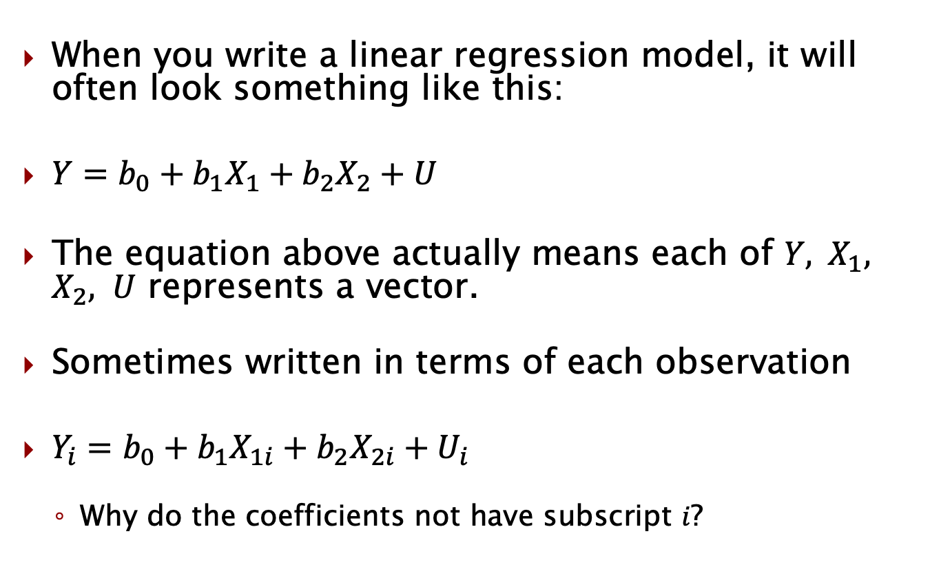
Writing a linear regression model
When you write a linear regression model, it will often look something like this:
$Y=b_{0}+b_{1}X_{1}+b_{2}X_{2}+U$
The equation above actually means each of $Y, { X}_{1}, X_{2}, U$ represents a vector.
Sometimes written in terms of each observation
$Y_{i}=b_{0}+b_{1}X_{1i}+b_{2}X_{2i}+U_{i}$
Why do the coefficients not have subscript $i$?

Slide 5
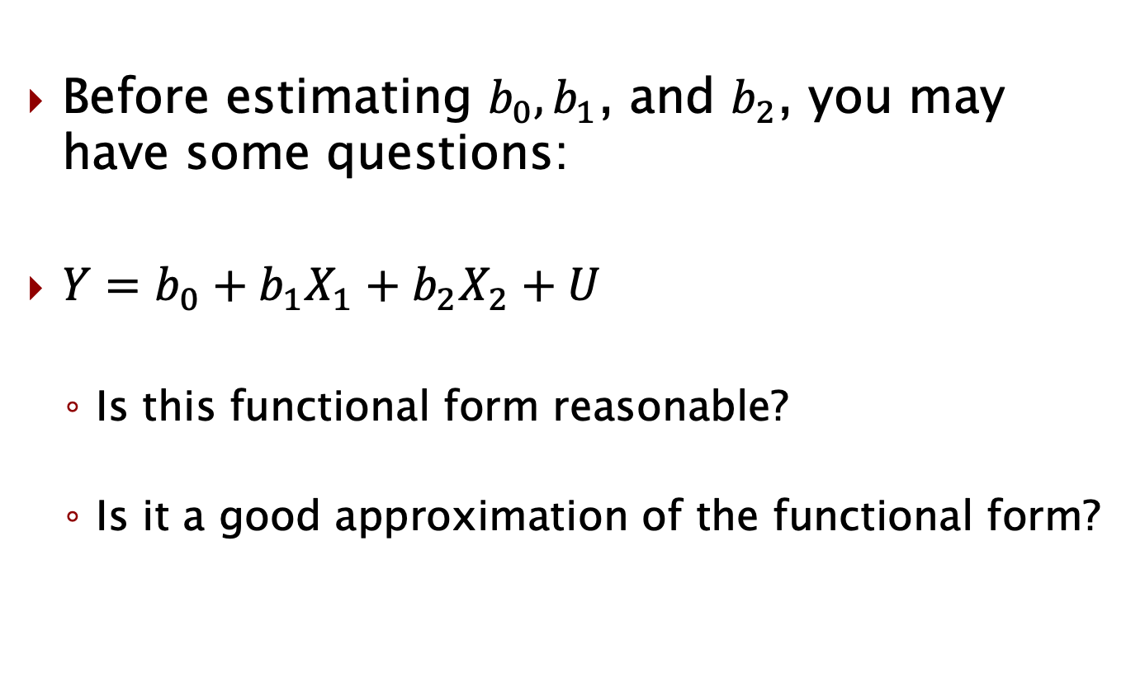
Other models?
Before estimating $b_{0}, b_{1}$, and $b_{2}$, you may have some questions:
$Y=b_{0}+b_{1}X_{1}+b_{2}X_{2}+U$
Is this functional form reasonable?
Is it a good approximation of the functional form?

Slide 6
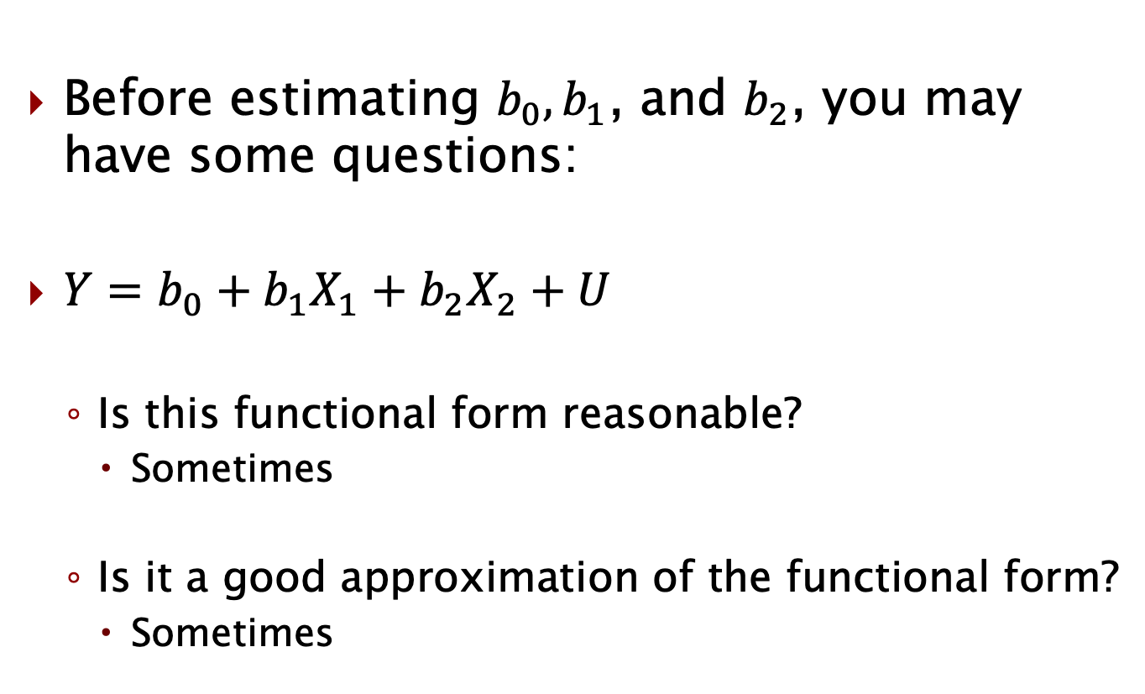
Other models?
Before estimating $b_{0}, b_{1}$, and $b_{2}$, you may have some questions:
$Y=b_{0}+b_{1}X_{1}+b_{2}X_{2}+U$
Is this functional form reasonable?
Sometimes
Is it a good approximation of the functional form?
Sometimes

Slide 7
Other functional forms
There are lots of cases where a more complex model might make sense:
Exponents
Logarithms
Etc.
We’ll discuss this a bit, but often this simple approximation is enough.
Also, we want to focus more on causality and although these issues aren’t totally separate, let’s ignore functional form issues at the moment.

Slide 8
Variable of interest
In the next example, we’ll consider a case where we have sales data on the quantity sold and price of chocolates.
If possible, we’d like to know the causal impact that price has on quantity sold.
So we can know whether we should change our price.
Price is the variable of interest.
Since we are interested in the causal impact it has
Be careful, Y is never the variable of interest
There can be more than 1, but we’ll often have 1

Slide 9
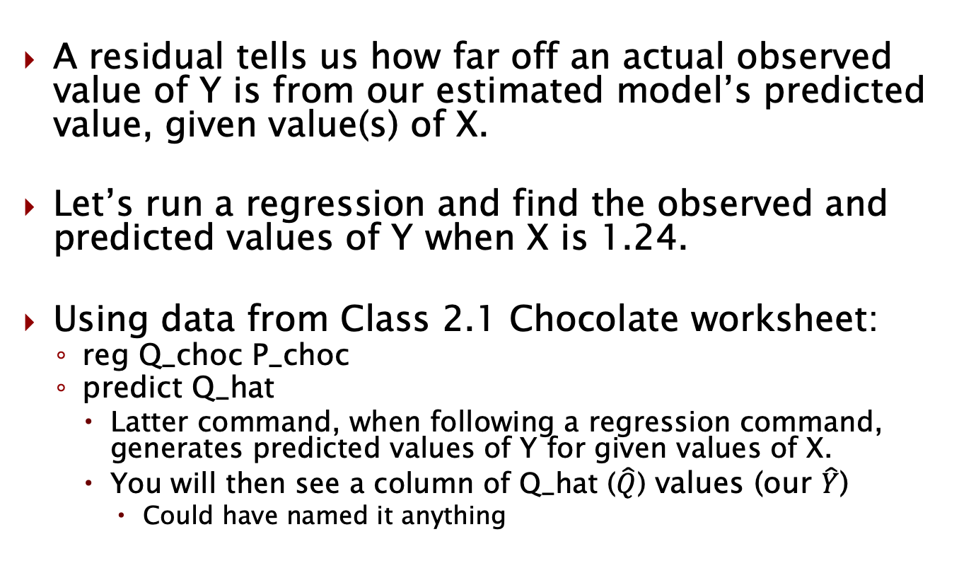
Residuals
A residual tells us how far off an actual observed value of Y is from our estimated model’s predicted value, given value(s) of X.
Let’s run a regression and find the observed and predicted values of Y when X is 1.24.
Using data from Class 2.1 Chocolate worksheet:
reg Q_choc P_choc
predict Q_hat
Latter command, when following a regression command, generates predicted values of Y for given values of X.
You will then see a column of Q_hat ($\hat{Q}$) values (our $\hat{Y}$)
Could have named it anything

Slide 10
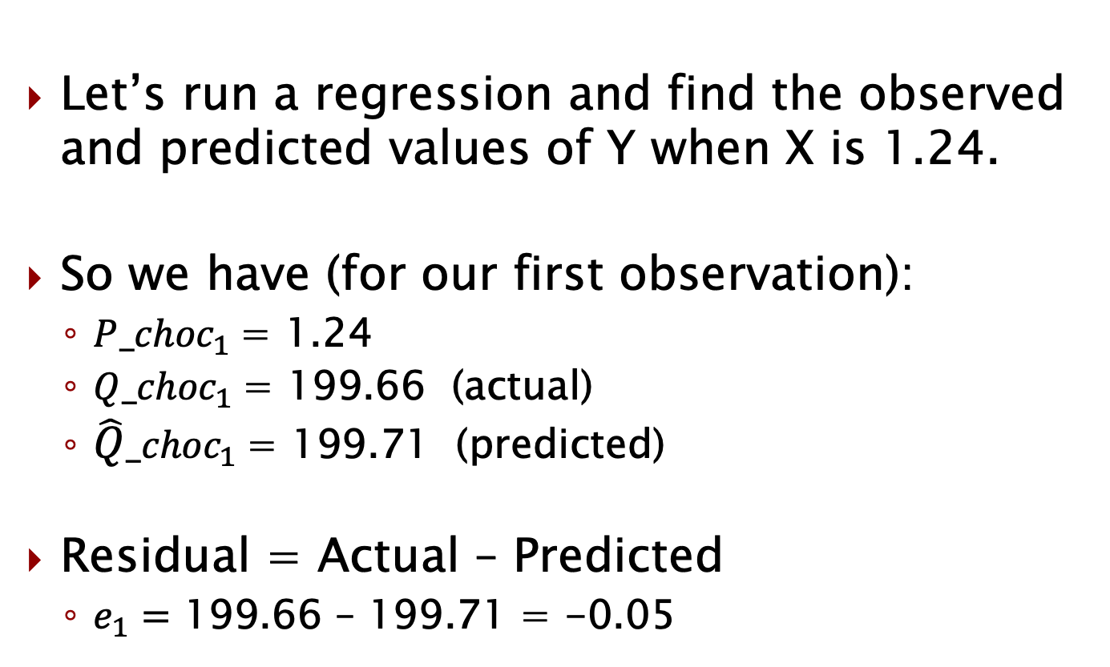
What is the residual?
Let’s run a regression and find the observed and predicted values of Y when X is 1.24.
So we have (for our first observation):
${P_choc}_{1}$= 1.24
${Q_choc}_{1}$= 199.66 (actual)
${\hat{Q}_choc}_{1}$= 199.71 (predicted)
Residual = Actual – Predicted
$e_{1}=$ 199.66 – 199.71 = -0.05

Slide 11
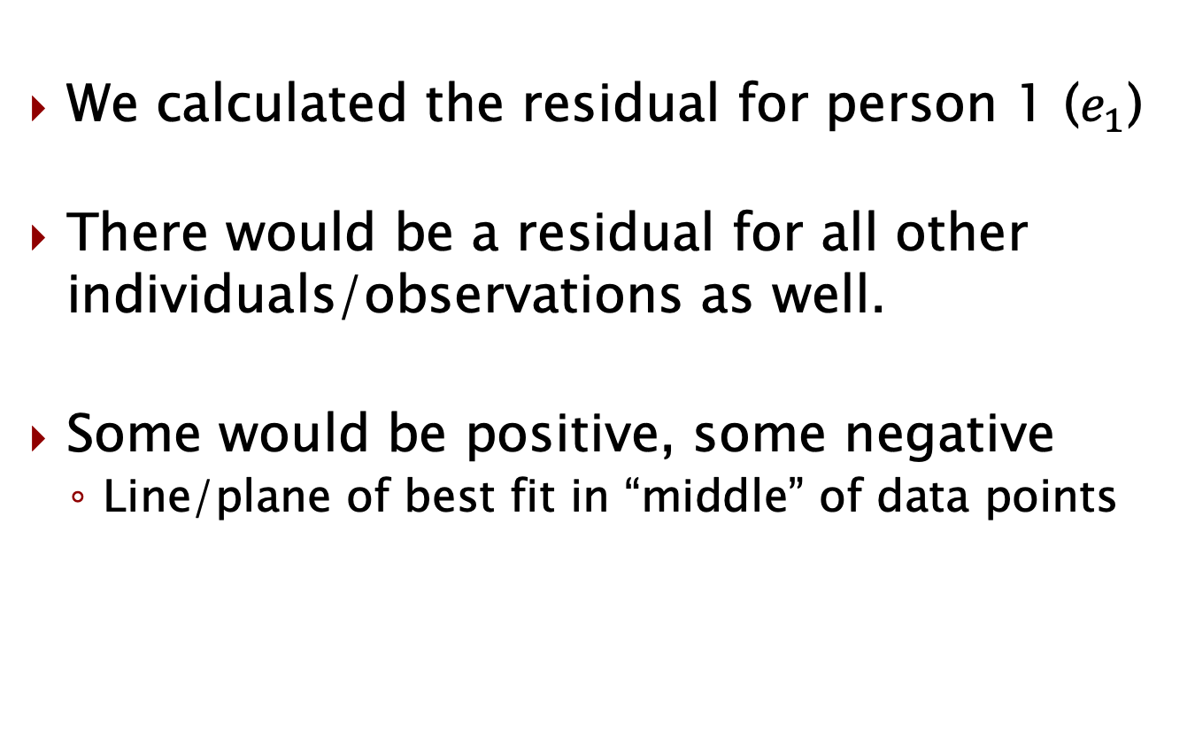
Residuals for every observation
We calculated the residual for person 1 ($e_{1}$)
There would be a residual for all other individuals/observations as well.
Some would be positive, some negative
Line/plane of best fit in “middle” of data points

Slide 12
Finding all residuals
We generally won’t need to, but if we wanted to see all residuals we could calculate them by subtracting:
Actual Y – Predicted Y
For every observation
Or, just like the predict command following reg
We can use:
predict Q_resid, residuals
The “comma + residuals” option tells Stata to calculate residuals
We could have used any name; Q_resid is arbitrary.

Slide 13
Residuals visualized
Let’s take a look at a scatterplot with the line of best fit so we can more clearly visualize the residuals for each observation.
twoway scatter Q_choc P_ choc || lfit Q_ choc P_ choc
This performs two separate commands on the same graph.

Slide 14
What is a residual?
How do we interpret each residual?

Slide 15
What is a residual?
How do we interpret each residual?
It may be tempting to think that the “truth” for the population is the line of best fit and that the residuals are simply the parts we can’t explain.
There certainly is a lot that we can’t explain
Lots of unobservables

Slide 16

What’s in U?

Slide 17
Are unobservables “balanced”?
Are the unobservables perfectly balanced around the line of best fit?

Slide 18
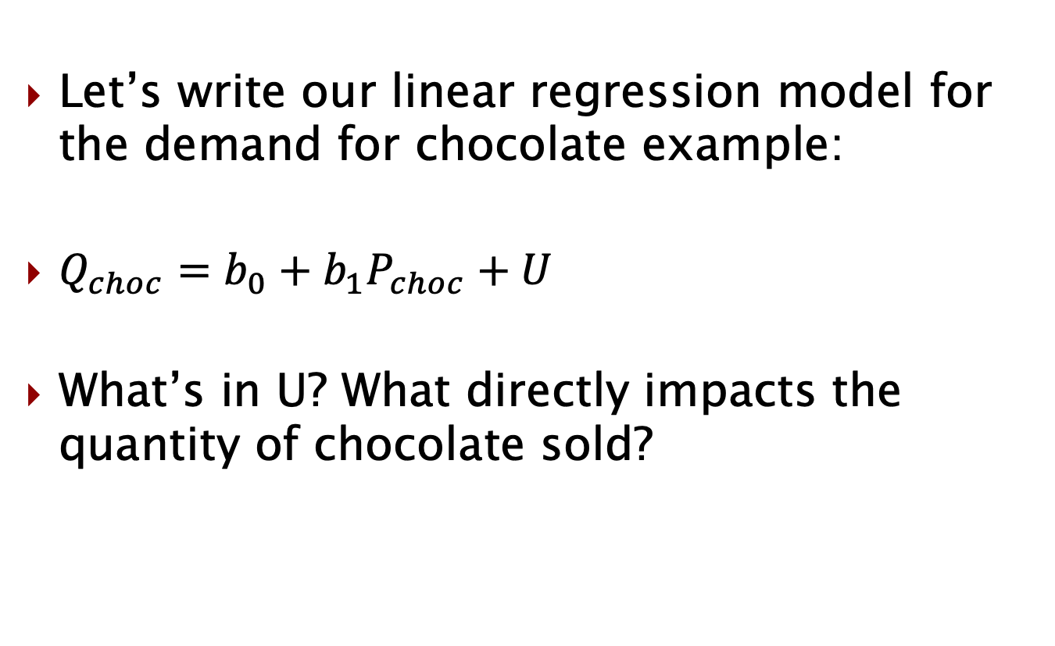
Going back to U
Let’s write our linear regression model for the demand for chocolate example:
$Q_{choc}=b_{0}+b_{1}P_{choc}+U$
What’s in U? What directly impacts the quantity of chocolate sold?

Slide 19
Lots of things…
Certainly there are a lot of things that directly impact the quantity of chocolate sold.
Brand, quality, type, etc.
Let’s imagine quality was the only thing so we can simplify our discussion.

Slide 20
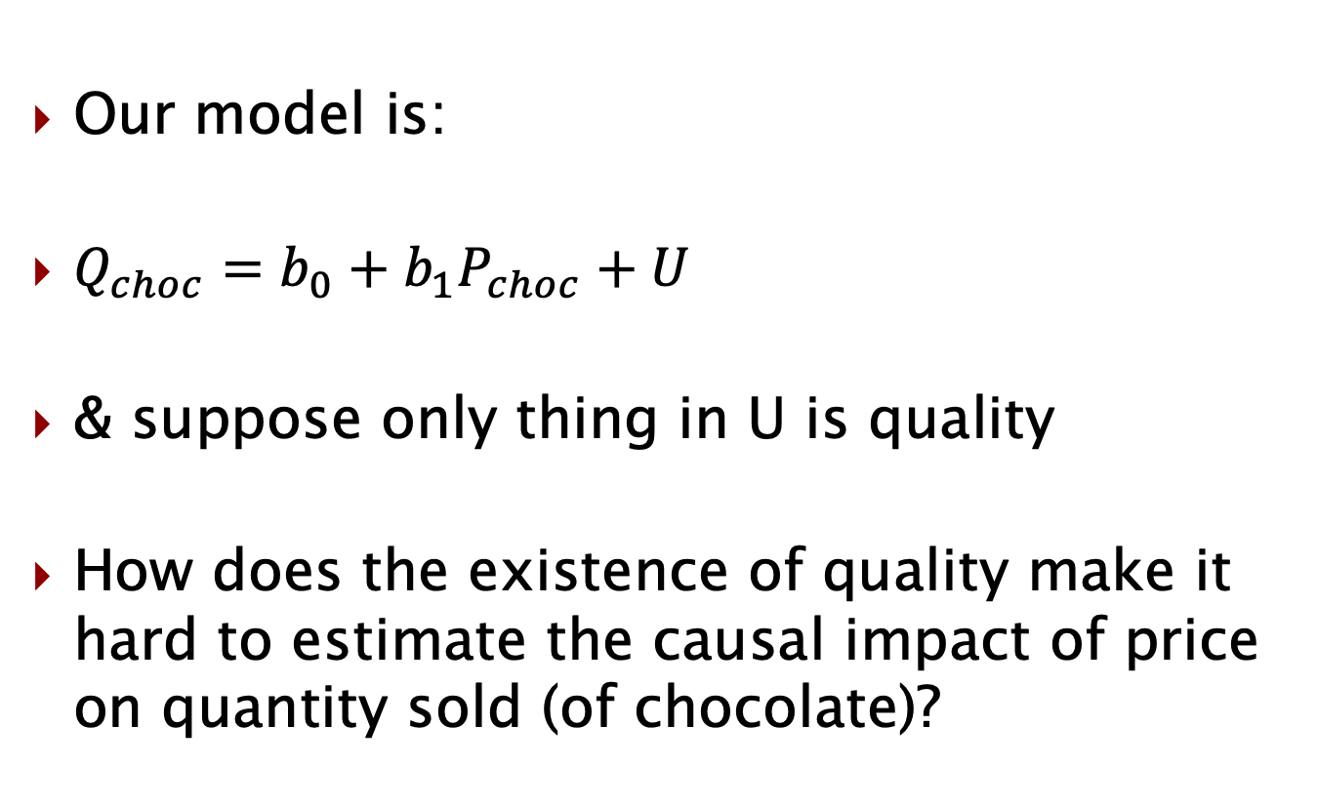
Back to the model
Our model is:
$Q_{choc}=b_{0}+b_{1}P_{choc}+U$
& suppose only thing in U is quality
How does the existence of quality make it hard to estimate the causal impact of price on quantity sold (of chocolate)?

Slide 21
Confounding factor
When we regress quantity on price in this example, we can’t be sure we’re picking up just the causal effect of price.
Or, if we are picking up the effect of price AND the effect of quality.
Often other things, but we assumed quality only
Quality’s existence causes bias in our estimate of the causal impact of price on quantity.
It messes up our ability to estimate the causal impact of price.

Slide 22
Can we see quality in data?
We said that quality is in U.
Can we see it in our data?
In a scatterplot?
In the spreadsheet?

Slide 23
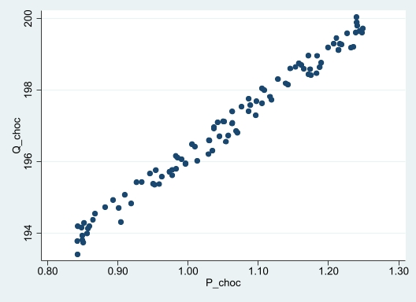
Where is quality?
What is the correlation between price and quality?

Slide 24
Where is quality?
We can’t observe quality, but since we strongly believe it directly impacts quantity sold and is correlated with price, our estimate of the causal impact of price on quantity sold will not be a good one.
This isn’t surprising since our coefficient on price was positive.
But quality would still almost certainly have created bias even if our coefficient was negative.

Slide 25
What if this had been an RCT
Let’s imagine we had some chocolate sales data, but that the vendor decided to randomly assign prices.
Suppose we again have data on Quantity sold & Price.
Would our model change? (if yes, how?)
Would U change? (if yes, how?)

Slide 26

Model and U when we have RCT
Our model is still (no change):
$Q_{choc}=b_{0}+b_{1}P_{choc}+U$
What about what is in U?

Slide 27
What’s in U?
Earlier we said that things that would be in U for chocolate would be:
Brand
Quality
Type
Etc.
These things are still in U (since they directly impact our Y (which is Quantity)

Slide 28
What’s different then?
A couple of things are different here though.
When we started with observational data and we assumed quality was the only thing in U, we discussed how quality was correlated with Price.
Is quality correlated with Price in the RCT?
Is brand correlated with Price in the RCT?
Is type correlated with Price in the RCT?

Slide 29
RCT Setup
Suppose we had data on chocolate quantity sold and price from the RCT.
If we did a scatterplot, what would you expect to see?
Think about what the random cases you’d see:
High prices on high quality
Low prices on high quality (*)
High prices on low quality (*)
Low prices on low quality
Sketch out your own scatterplot
Start with extremes (*)

Slide 30
Quantity and price
How does your fictional scatterplot (from a fictional RCT) likely differ from a scatterplot from observational data if we only have quantity and price data?
For example:
Restaurants
Hotels

Slide 31
When to care about U?
So when should we care about U? (& why?)
When should we care less about U? (& why?)

Slide 32
How is this related to sampling dist’n?
You may wonder how a confounding factor like quality is related to the sampling distribution discussion we had previously.
It’s a related, but mostly a separate conversation about what our sample can/can’t tell us.
Consider three different sampling distributions:
Heights of adults in Indiana
Effect of price on quantity of chocolate sold (observational)
Effect of price on quantity of chocolate sold (experimental)

Slide 33
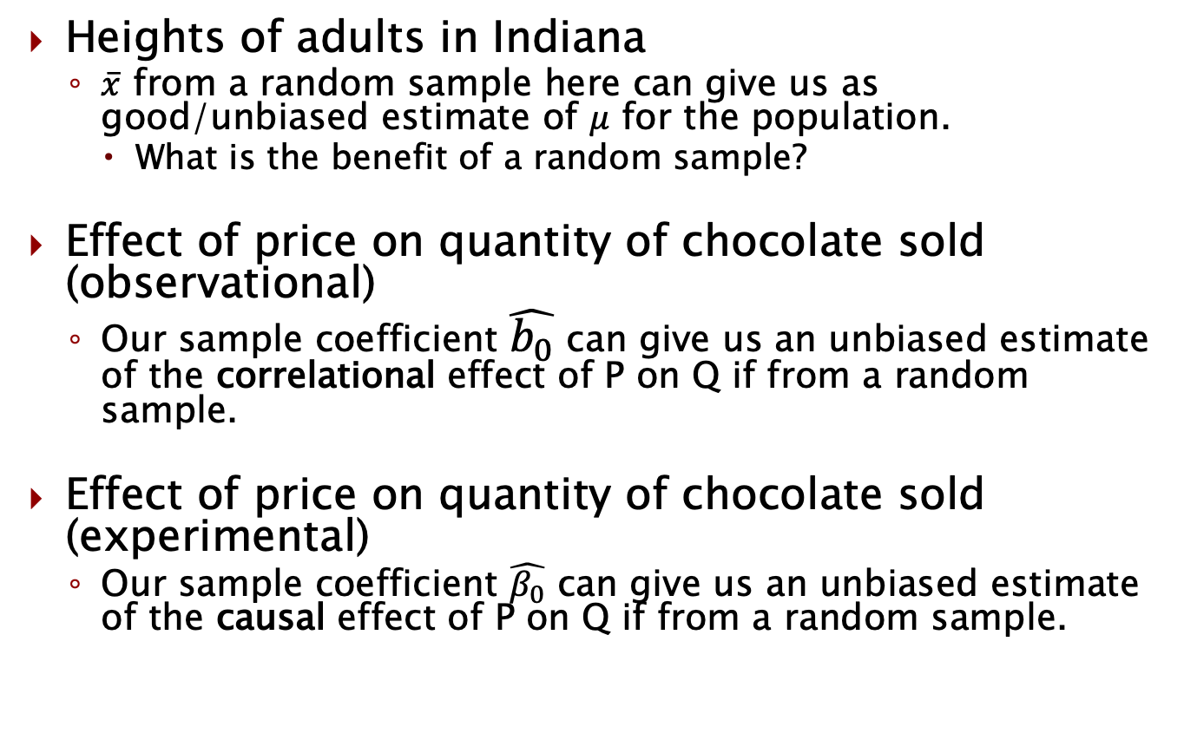
What can we learn?
Heights of adults in Indiana
$\overline{x}$ from a random sample here can give us as good/unbiased estimate of $μ$ for the population.
What is the benefit of a random sample?
Effect of price on quantity of chocolate sold (observational)
Our sample coefficient $\hat{b_{0}}$ can give us an unbiased estimate of the correlational effect of P on Q if from a random sample.
Effect of price on quantity of chocolate sold (experimental)
Our sample coefficient $\hat{β_{0}}$ can give us an unbiased estimate of the causal effect of P on Q if from a random sample.

Slide 34
Random sample vs random assignment
We’ve used the word random in two completely different ways. What is the difference and the benefit of each/either?
Random sample
Random assignment (of the treatment)

Slide 35
Random sample vs random assignment
We’ve used the word random in two completely different ways. What is the difference and the benefit of each/either?
Random sample
We ideally would want a random sample of the population so that we can extrapolate the results we get out to the broader population.
This is true for experimental and for observational.
Random assignment (of the treatment)
In an RCT, once you have your sample, you randomly assign who/what gets what treatment status.
This is why nothing should be correlated with the treatment and allows us to draw a causal inference from differences in the outcomes.

Slide 36
Bias in causal inference
When would we say our estimates are biased/unbiased?
It depends on what we are trying to estimate.
If we want to estimate the causal effect of price on quantity for some population, we need:
A random sample
Often settle for representative sample
An exogenous model (RCT gets us, others to come)
Not having the first means our population looks different than the sample.
Not having the second means we have some (unobserved) confounding factor that is correlated with our variable of interest whose effect we are picking up along with the variable of interest.

Slide 37
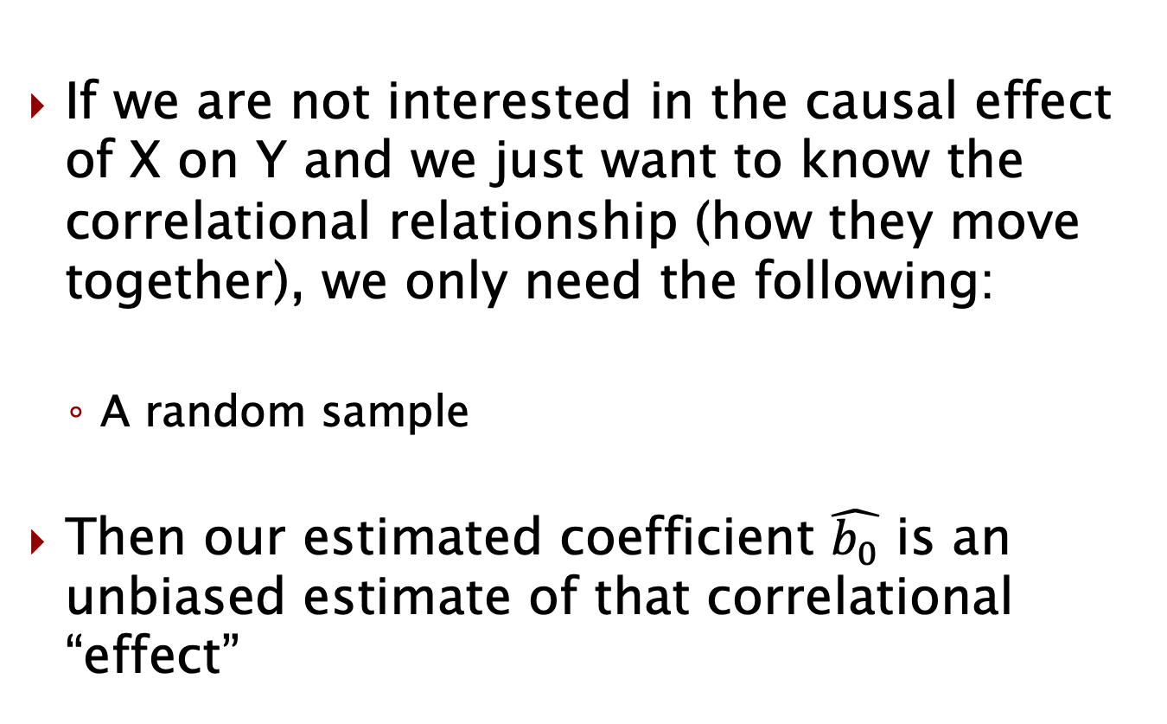
Bias in correlation
If we are not interested in the causal effect of X on Y and we just want to know the correlational relationship (how they move together), we only need the following:
A random sample
Then our estimated coefficient $\hat{b_{0}}$ is an unbiased estimate of that correlational “effect”

Slide 38
What we’ve learned
What the U term means
All unobserved factors that directly impact Y
When we care what is in U
When we are interested in causality and when we don’t have an RCT
Possible sources of bias
Sample not random
Model not exogenous (if interested in causality)
We’ll learn more about this later, but for now just know RCT gets us exogeneity of the model

Slide 39
Announcements/reminders
PS1 (group) due Sunday (1/22)
Discussion 1 due Sunday (1/22)
Quiz 1 Friday (1/27)
Available noon – 11:59pm
Up to 40 minutes
By yourself on Canvas
Practice quiz & solutions available
Through class 2.2

